Slide 1

Go, change the world
RV College of
Engineering
Examples of Race
Conditon Prevention

Slide 2
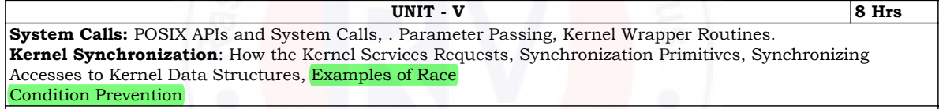
Race condition Prevention

Slide 3
INDEX
Recap
Introduction
Reference Counters
Big Kernel Locks
Memory Descriptor RW Locks
Inode Semaphores

Slide 4
RECAP
We have seen synchronization primitives to avoid race condition
Here, we will see synchronization and race condition avoidance with respect to kernel control paths
Mutexes
Condition Variables
Monitors

Slide 5
INTRODUCTION
KERNEL
Server that answers
requests
Process running
on CPU
Interrupt request from external device
Parts of the kernel are not run serially,
but in an interleaved way
Thus, they can give rise to RACE CONDITIONS

Slide 6
INTRODUCTION
Thus, they can give rise to RACE CONDITIONS
They need to be controlled
through proper
SYNCHRONIZATION techniques

Slide 7
Reference Counter
It is a mechanism used to keep track of how many references there are to a particular resource
Resources:
Memory Page Blocks of virtual memory managed by the OS
Modules: Code that can be dynamically loaded into the kernel (device driver, file system driver)
Files: Regular files that has some data
Memory Pages
Modules
Files

Slide 8

Reference Counter
They ensure the resource is not prematurely freed while still in use
The reference counter is implemented using an atomic data type, specifically atomic_t in Linux (https://www.kernel.org/doc/Documentation/atomic_t.txt)
Process starts using the resource, the counter is incremented
Process is done using the resource, the counter is decremented
If the counter reaches zero, it means no process is using the resource, and it can be safely released
atomic_t

Slide 9
BIG KERNEL LOCK (BKL)
It is a mechanism to
It is a global lock that prevents multiple processors from running kernel code simultaneously, thereby avoiding race conditions
manage access to shared resources and
ensure mutual exclusion within the kernel
Processor 1
Processor 2
Processor 3
Kernel MODE

Slide 10
BIG KERNEL LOCK (BKL)
Linux 2.0
The BKL was implemented as a crude spin lock
It ensured that only one processor could be in kernel mode at any time
The kernel became more flexible
Multiple Spin Locks for different kernel data structures were introduced, reducing reliance on a single global lock
The BKL was still present but used less frequently
Linux 2.4

Slide 11
BIG KERNEL LOCK (BKL)
Linux 2.6.11
Semaphore based BKL
The BKL is implemented using a semaphore named
(Semaphore is a synchronization primitive that is better than a spin lock as it allows preemption and improved system responsiveness)
Semaphore operation “up” and “down” are used acquire and release BKL
It is not a simple semaphore. Each process descriptor includes a field that allows a process to acquire the BKL multiple times
kernel_sem
lock_depth

Slide 12
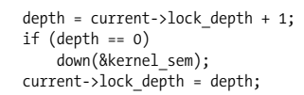

BIG KERNEL LOCK (BKL)
Semaphore
kernel_sem
New Process A has lock_depth = -1 Process decrement (0)
depth = 0 acquired SEMAPHORE Process decrement (-1)
lock_depth = 0 lock_depth = -1
New Process B within Process RELEASE the Semaphore
depth = lock_depth + 1 = 0 + 1 = 1
Doesn’t need to acquire semaphore
lock_depth = 1
lock_kernel ()
unlock_kernel ()
A
B
A
A
B
A

Slide 13
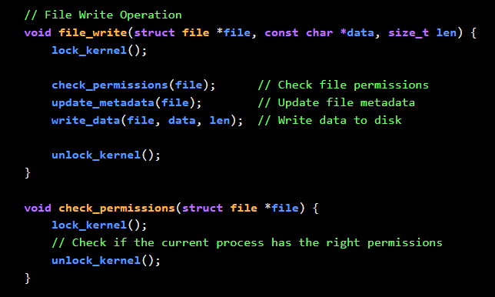
Eg: File Write Operation
kernel_sem <=> file_write = 0
depth = lock_depth + 1 = 0 SEMAPHORE acquired
depth = lock_depth + 1 = 1
PREEMPTION (When higher priority interrupt/process arrives)
lock_kernel ()
lock_kernel ()

Slide 14
Memory descriptor r/w semaphore
Memory Descriptor Kernel DS with process’ memory info
If NO free memory (Suspended)
mem_struct
Code, Data, Stack, Heap, Shared Library
Shared among
THREADS
mmap_sem
semaphore
Thread 1: Writer
Thread 2: Reader
Thread N
do_mmap()
allocates (vm_area_struct)
mem_struct
Inconsistent
tries to read inconsistent mem_struct
Data corruption

Slide 15
Memory descriptor r/w semaphore
If NO free memory (Suspended)
Thread 1: Writer
Thread 2: Reader
Thread 3:
Writer
down_write(mmap_sem)
down_read(mmap_sem)
down_write(mmap_sem)
do_mmap()
allocates vm_area_struct
BLOCKED
BLOCKED
UNBLOCKED
Thread 4
down_read(mmap_sem)
“acquired”
Memory FREED
Execute and Exit if it doesn’t read/write
up_read(mmap_sem)
up_write(mmap_sem)

Slide 16
INODE SEMAPHORE
inode
(Index Node) Data Structure that contains metadata about file
File Type
Permissions
Pointer to ACTUAL Data
i_sem
Process A (Listing the Files) leads to Race Condition Process B (Adding/Removing files in that directory)
i_sem (semaphore) prevents multiple processes from concurrently modifying/accessing the inode in a conflicting manner
Potential for Deadlock: When a process wants 2 or MORE semaphores rename() in Linux: Semaphore for Source inode and Destination inode
Solution: All Processes acquire semaphore in the same, predefined order

Slide 17
THANK YOU

